Slide 1


Department of Computer Engineering
Main Presentation
Under
Industrial Training Presentation(3CS7-30)
Session-2023-24(Odd)
Presented by
Student Name: ISHU KUMAR
Student Name: KAPIL VINAYAK
Student Name: JATIN SHARMA
Section: 7CS-B
Presented to
Faculty Name: SHIKHA GAUTAM

Slide 2

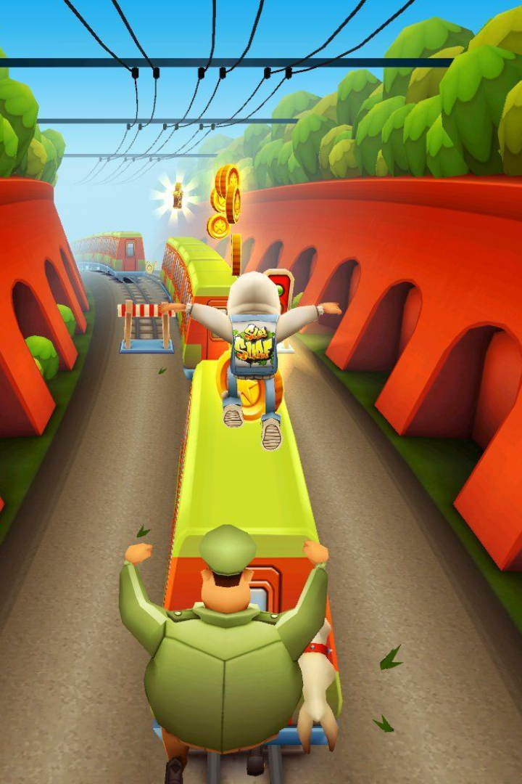
PROJECT TITLE
AI-Powered Game Controller and Interaction System
Discover how we integrated pose detection deep learning model into game to take gaming to the next level with enhanced experiences and personalized challenges.
Key features include gesture-based controls, voice commands, automated gameplay, chatbot integration, and application to online games, collectively offering a hands-free and engaging gaming experience.

Slide 3
Overview of Subway Surfers Game
Gameplay Mechanics
Objectives
Popularity
Subway Surfers is an endless runner game that challenges players to run through a subway while avoiding obstacles and collecting coins.
Players are tasked with running as far as possible, collecting coins, and unlocking new character skins and upgrades.
With over 2 billion downloads, Subway Surfers has become one of the most successful mobile games of all time.

Slide 4
Pose Detection in Deep Learning
1
Definition
Pose detection is the process of identifying and tracking human body movements in real-time using machine learning algorithms.
Deep Learning Model
2
We use OpenPose, a deep learning model that can identify 25 body parts and landmarks with high accuracy.
3
Applications
Pose detection has many applications, including gaming, fitness, and interactive art installations.

Slide 5
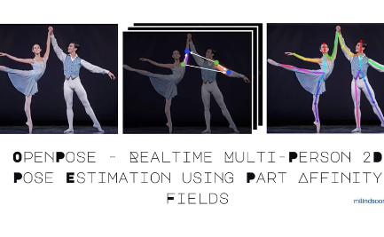

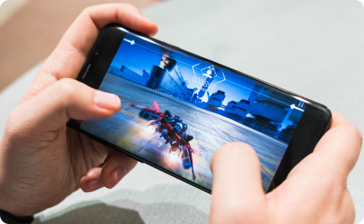
Integration of Pose Detection in Subway Surfers
Implementation
Accuracy
Customization
We integrate OpenPose into Subway Surfers to track player movements and detect gestures such as jumping, crouching, and dodging.
With OpenPose, we achieve highly accurate pose detection, allowing for precise gameplay and personalized challenges.
Players can customize their gameplay by adjusting the sensitivity of the pose detection model to fit their individual preferences.

Slide 6

Advantages of Playing Subway Surfers With AI
1
Enhanced Gaming Experience
2
Improved Accuracy and Efficiency
With AI, players enjoy more responsive gameplay, smoother animations, and dynamic challenges.
Pose detection allows for more accurate and efficient control of the game, reducing error and frustration.
3
Personalized Gameplay and Challenges
With customizable sensitivity settings, players can tailor the game to their individual skill level and preferences.

Slide 7
Challenges and Limitations
1
Technical Constraints
Pose detection requires significant computational power, which may limit its use on low-end devices.
System Requirements
2
Playing with AI requires a stable internet connection and the latest version of Subway Surfers with pose detection functionality.
3
Potential Challenges
AI-powered games may face potential challenges related to data privacy, system security, and ethical considerations.

Slide 8
Conclusion
Recap
Future Possibilities
By integrating pose detection deep learning model into Subway Surfers, players enjoy enhanced experiences, personalized challenges, and improved accuracy and efficiency.
The integration of AI into gaming opens up new possibilities for interactive and immersive experiences, signaling a paradigm shift in the gaming industry.

Slide 10


Slide 11


Slide 13
Thank you😊.

